Slide 1


Harmful Brain activity Classification
02216822 Subin Hyun

Slide 2


Slide 3
Data source: Samsung Seoul clinic
Data source: WHO

Slide 4




Goal
Classify harmful brain activity patterns
Early diagnosis of cerebral diseases
Reduce the cost and time of EEG test
Reduce the number of experts needed in EEG analysis

Slide 5
Index
Method
Result
Discussion
Introduction (dataset overview)
Related Works (previous studies)

Slide 6
Dataset overview
Comprehension of metadata and preprocessing

Slide 7
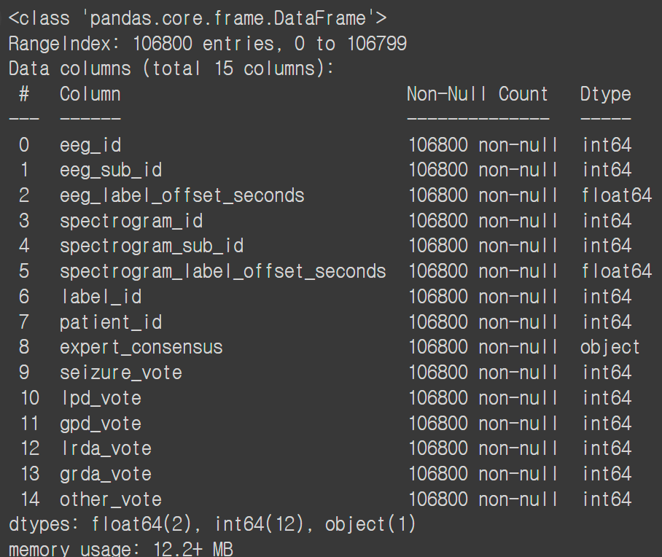
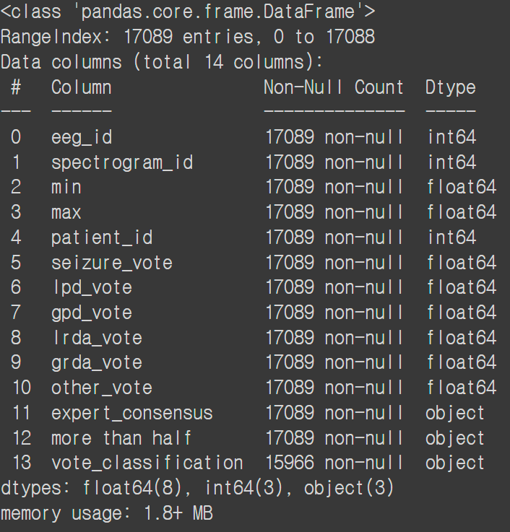
Train metadata

Slide 8
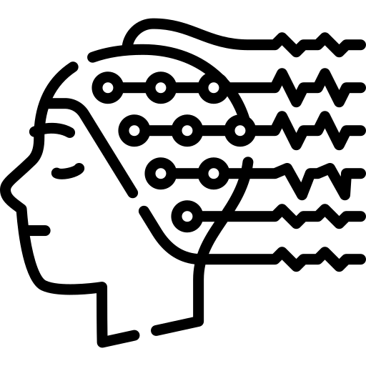
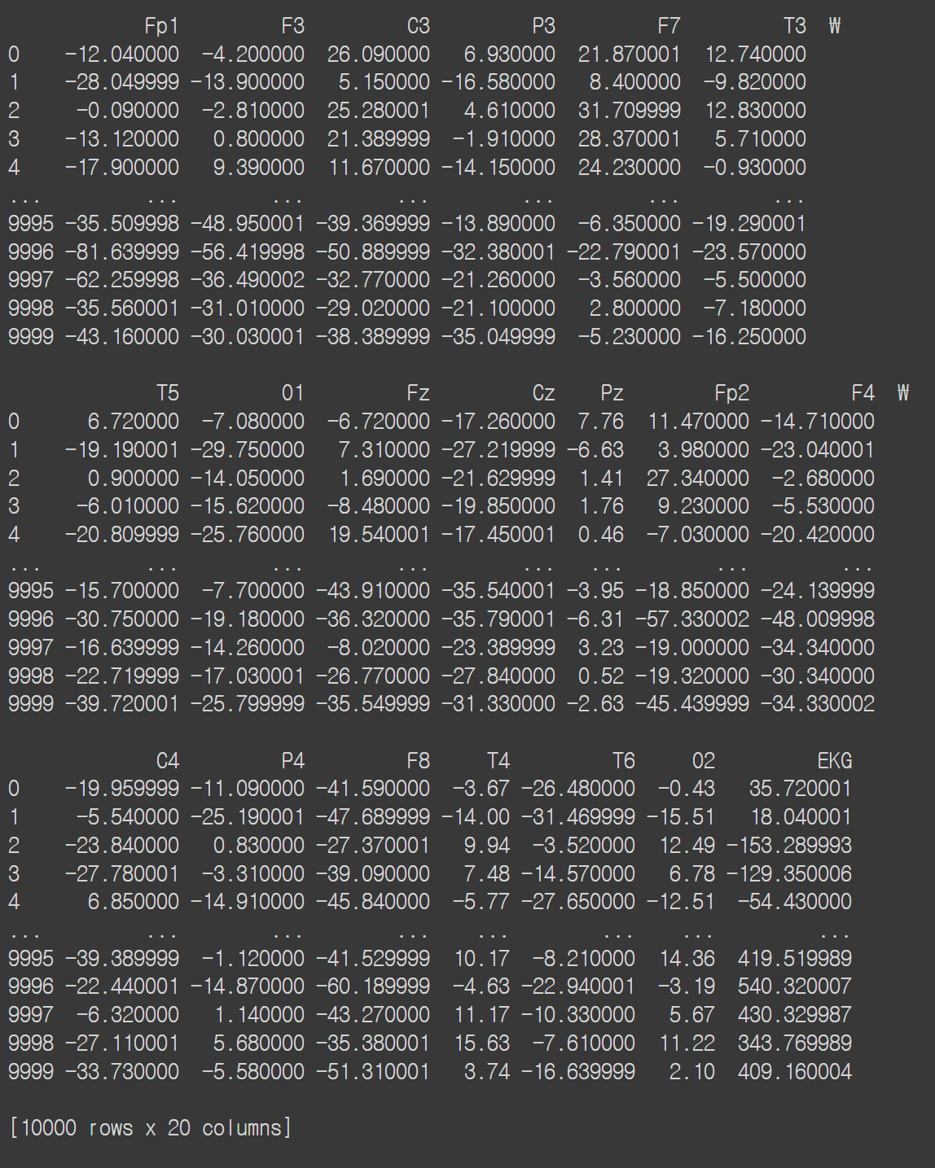
Electroencephalogram (EEG)
Captures the electrical signal from neural cells

Slide 9
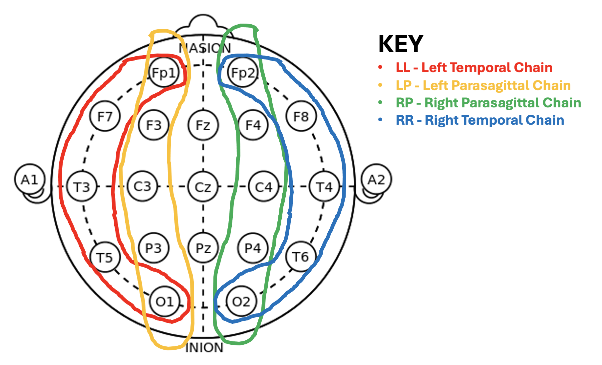
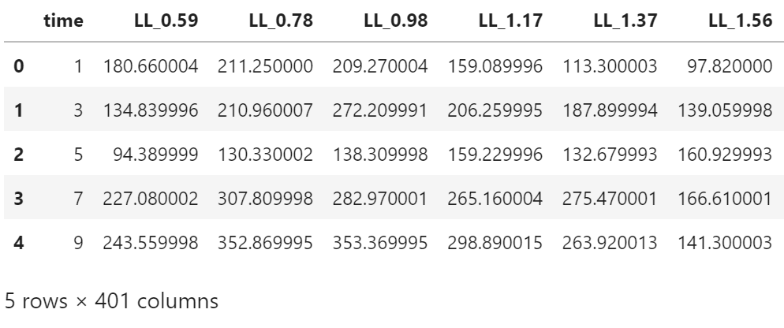
Spectrogram
Assembled data of EEG
Columns based on the location index of EEG
Match with EEG series by using the metadata of the dataset

Slide 10
General EEG signal classification
Delta
0.5Hz~4Hz
Theta
4Hz~7Hz
Alpha
8Hz~13Hz
Beta
14Hz~20Hz

Slide 11
Harmful pattern classification
Seizure
LPD
GPD
LRDA
GRDA
Others
Harmful Brain Activity

Slide 12
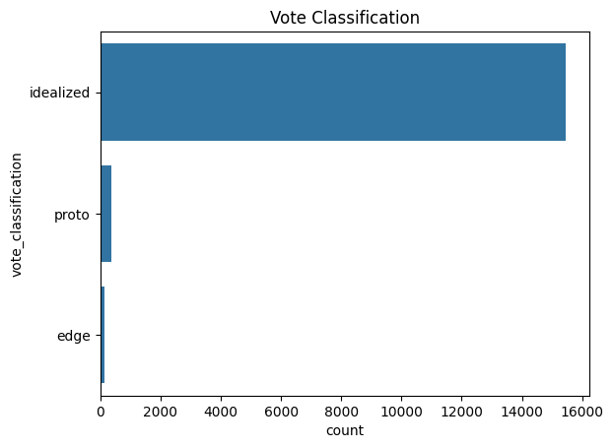
Data reliability
[grda_vote, other_vote] | 137
[lpd_vote, other_vote] | 94
[gpd_vote, other_vote] | 53
[lrda_vote, other_vote] | 46
[seizure_vote, other_vote] | 38
15461
[seizure_vote, lpd_vote] | 35
[lpd_vote, gpd_vote] | 31
[seizure_vote, gpd_vote] | 29
[lpd_vote, lrda_vote] | 19
[gpd_vote, grda_vote] | 13
[lrda_vote, grda_vote] | 7
[seizure_vote, grda_vote] | 2
[seizure_vote, lrda_vote] | 1
368
137

Slide 13
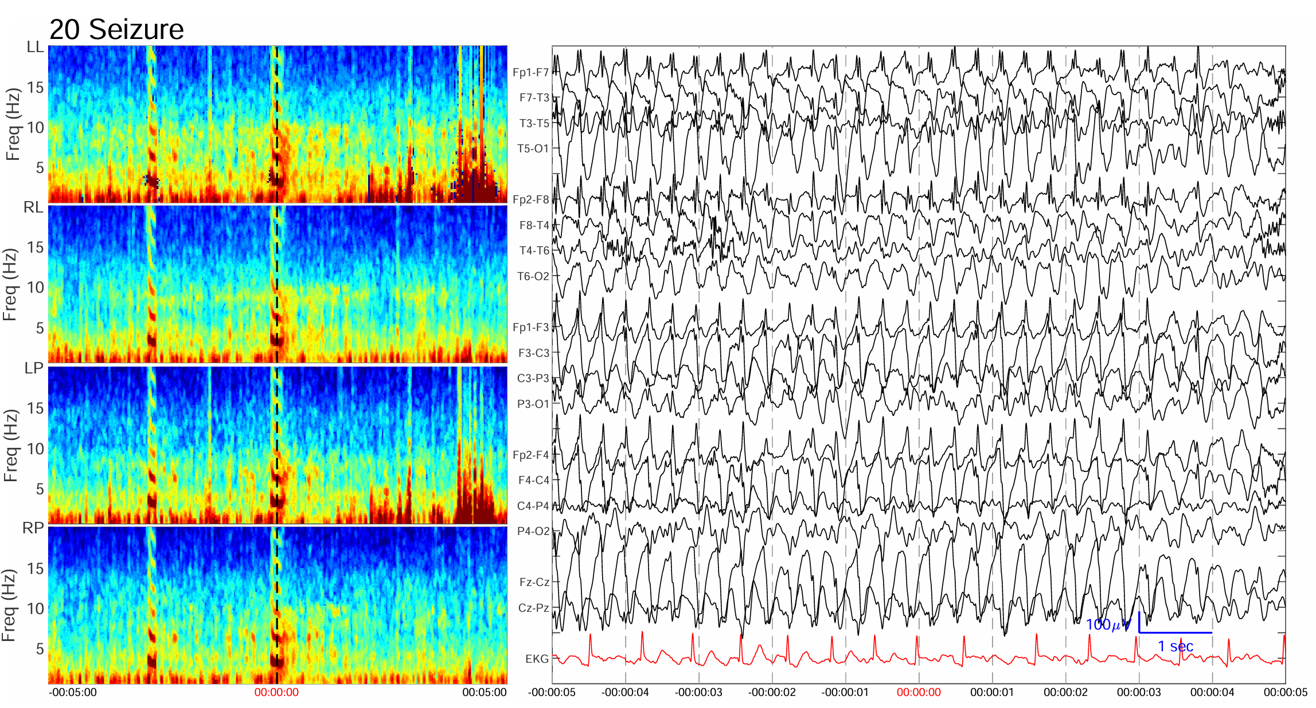
Sample figures-idealized case

Slide 14
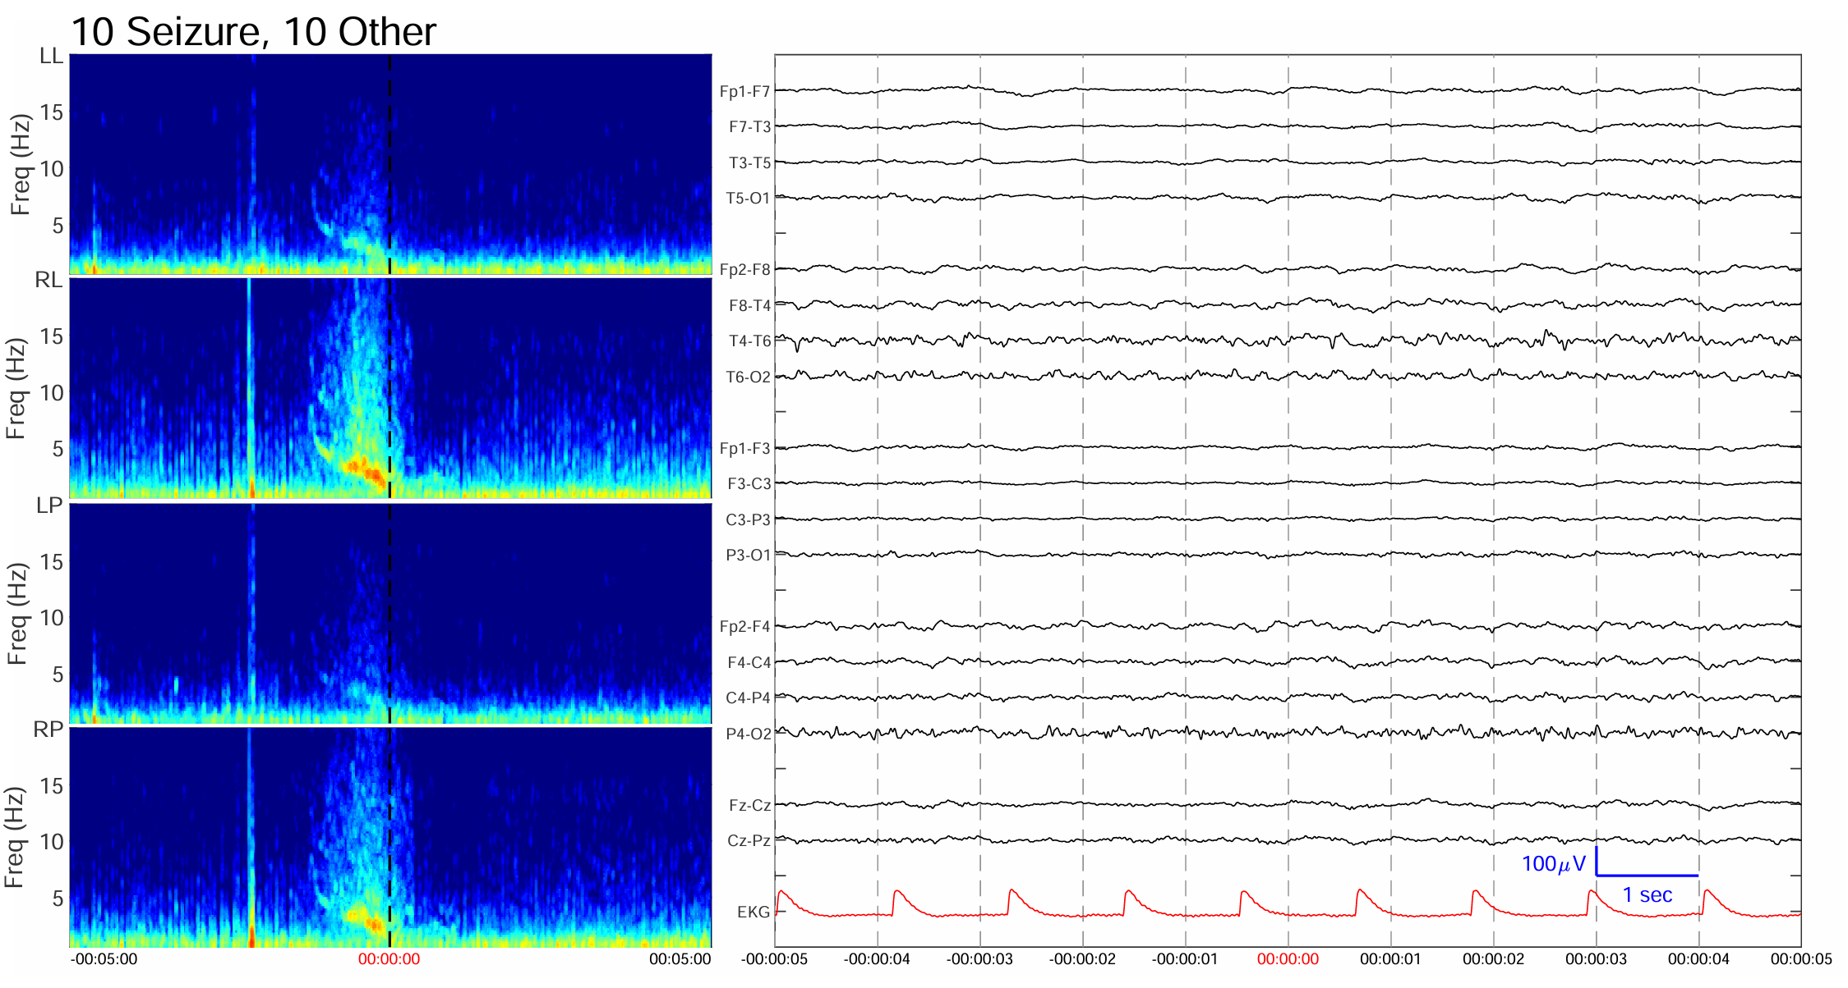
Sample figures-proto case

Slide 15
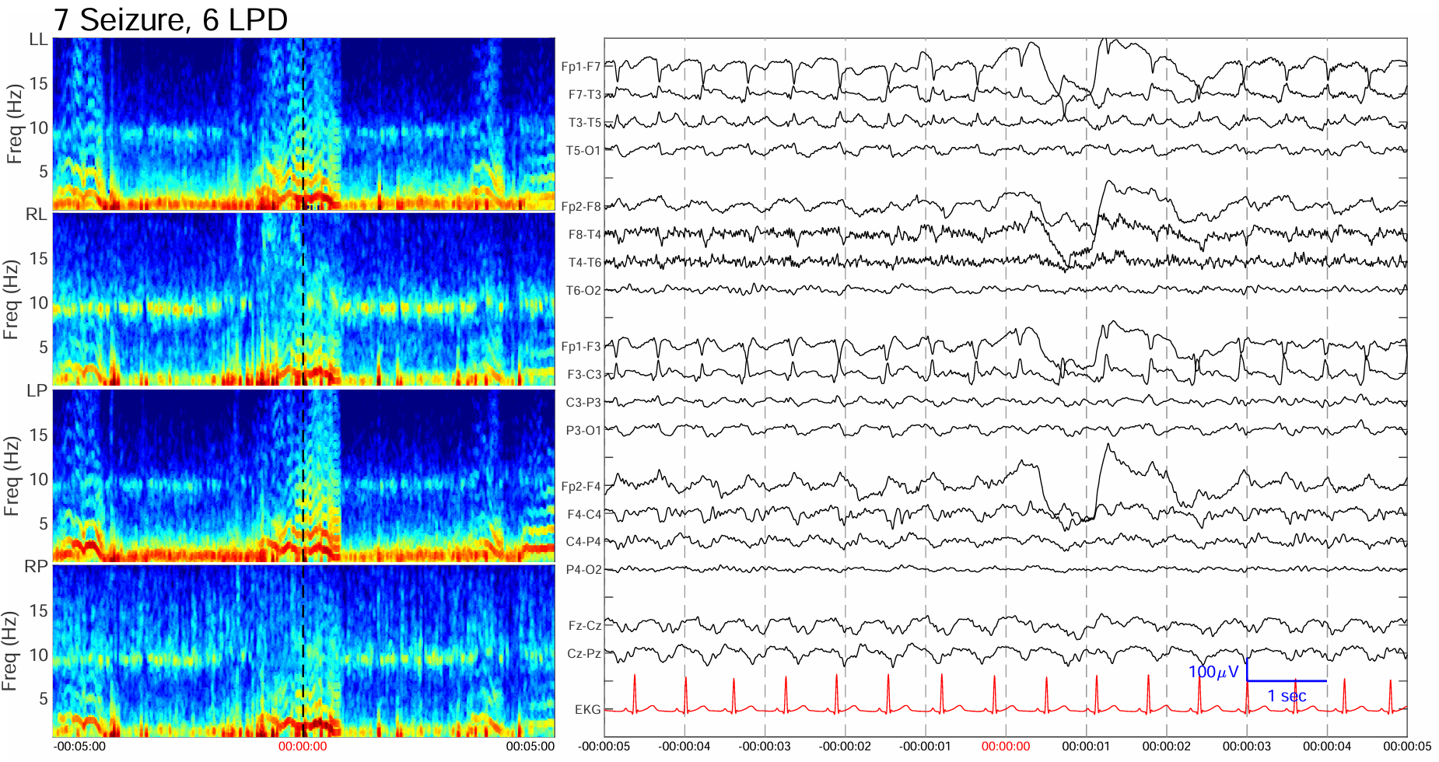
Sample figures-edge case

Slide 16
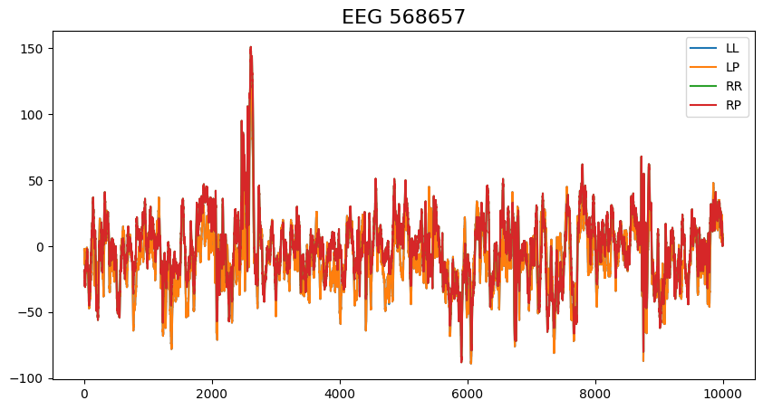
Overall plan for model training & Challenges
EEG signal preprocessing
Signal to image
CNN
modeling
Model training
Delete EKG Artifact, different weight to each case (idealized, proto, edge)
Wavenet model
(wavelet + CNN)
EEG-Spectrogram image(using STFT) and graph matching
Train all the graphs and labels

Slide 17
Previous studies
Previous studies related to this project and some references of the idea

Slide 18
Others’ solutions in Kaggle competition
Team sony solution (1st place): summarized raw eeg by cropping the middle 10,000 frames, used 2D model and replaced softmax to entmax
Team holiday solution (2nd place): different weight for each pattern label, filtered raw signal, 3D CNN for spectrum(spectrogram), and 2D CNN for raw eeg signal
Team nvidia solution (3rd place): used solid cross validation, validation data filtered by the number of vote (only more than 9), added buffer to raw signals, and mixed 1D/2D CNN models
Team Chris solution (8th place): used Wavenet (Wavelet + CNN) model, chained eeg signals and used folding

Slide 19
References
Kaggle notebook “How to make Spectrogram from EEG” by Yannis
Kaggle notebook “EfficientNetB0 Starter”, “Wavenet starter” by Chris
Journal references
Vishal_Kumar. (2021, December 14). Processing EEG data with python- Vishal_Kumar - Medium. Medium. https://medium.com/@vishal.mi19/processing-eeg-data-with python-8036fd7336ca
Van Den Oord, A., Dieleman, S., Zen, H., Simonyan, K., Vinyals, O., Graves, A., ... & Kavukcuoglu, K. (2016). Wavenet: A generative model for raw audio. arXiv preprint arXiv:1609.03499, 12.
Eun, H. J. (2019). Basics of Electroencephalography for Neuropsychiatrist. Journal of Korean Neuropsychiatric Association, 58(2), 76. https://doi.org/10.4306/jknpa.2019.58.2.76

Slide 20
Modeling
From modeling idea to
actual training

Slide 21
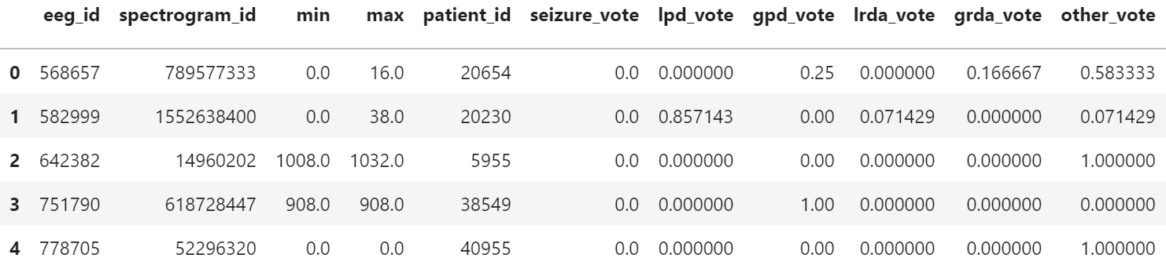
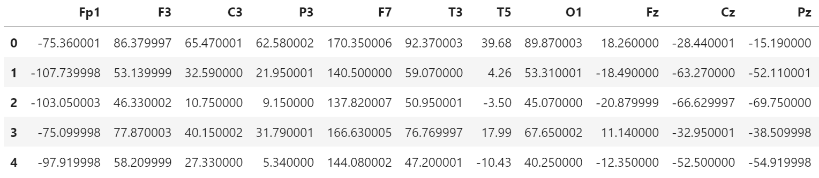
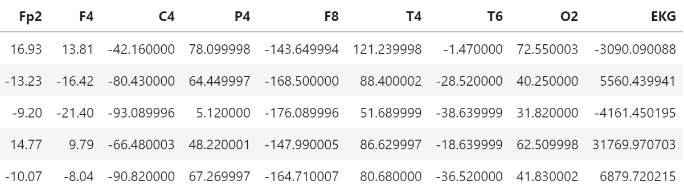
Image plotting
Train metadata
EEG id
EEG signal raw data (.parquet file)

Slide 22
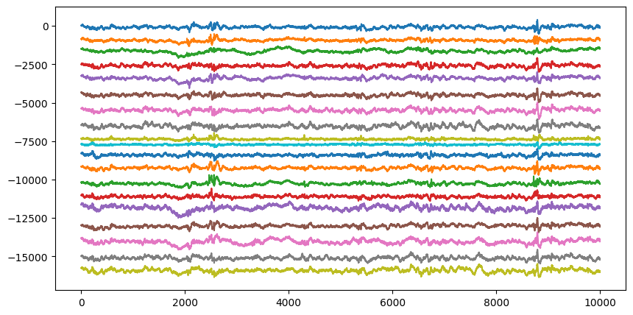
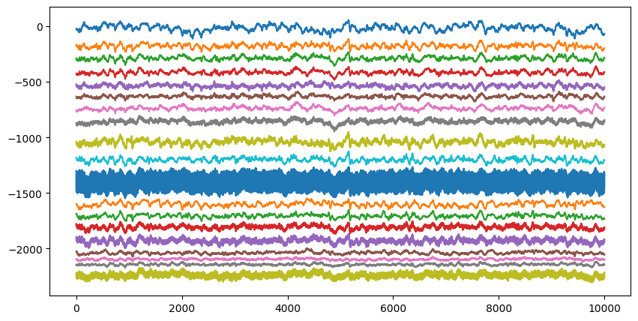
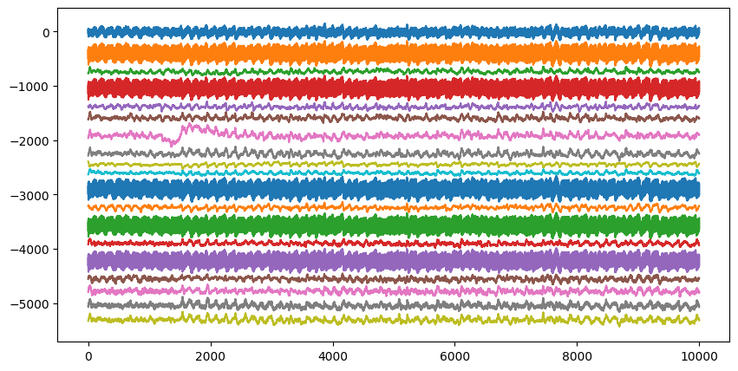
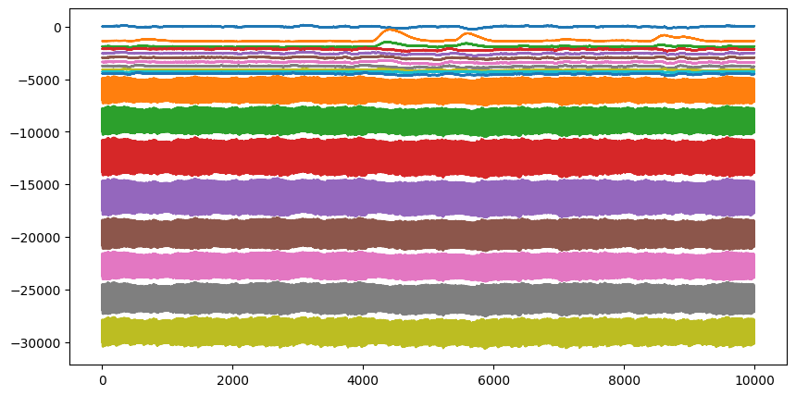
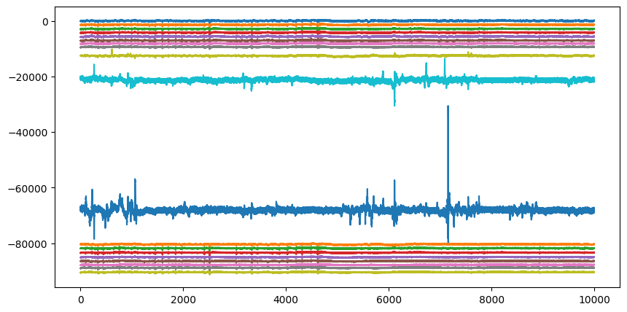
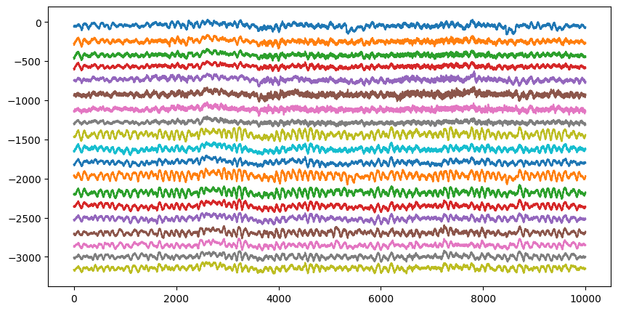
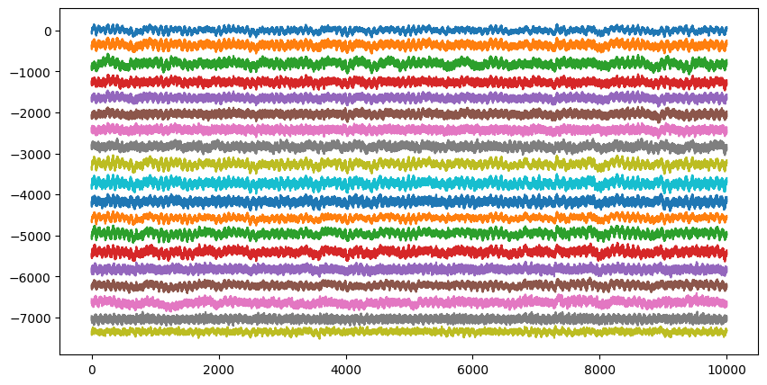
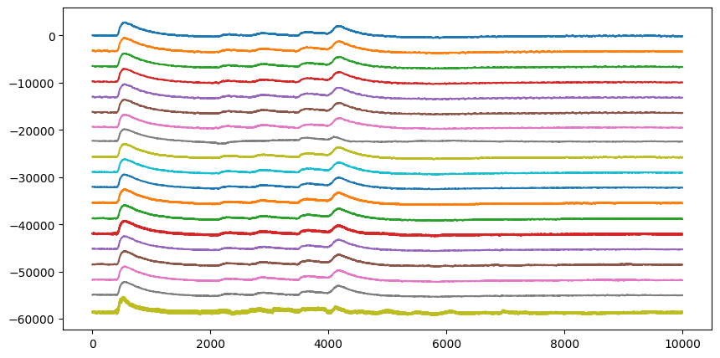
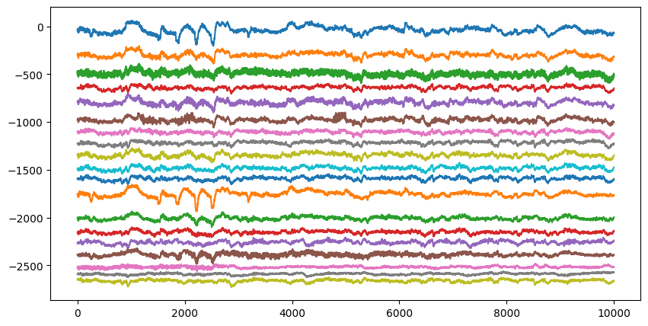
Train inputs

Slide 23
Modeling-model overview
Possibilities
CNN Model
Pattern Class

Slide 24
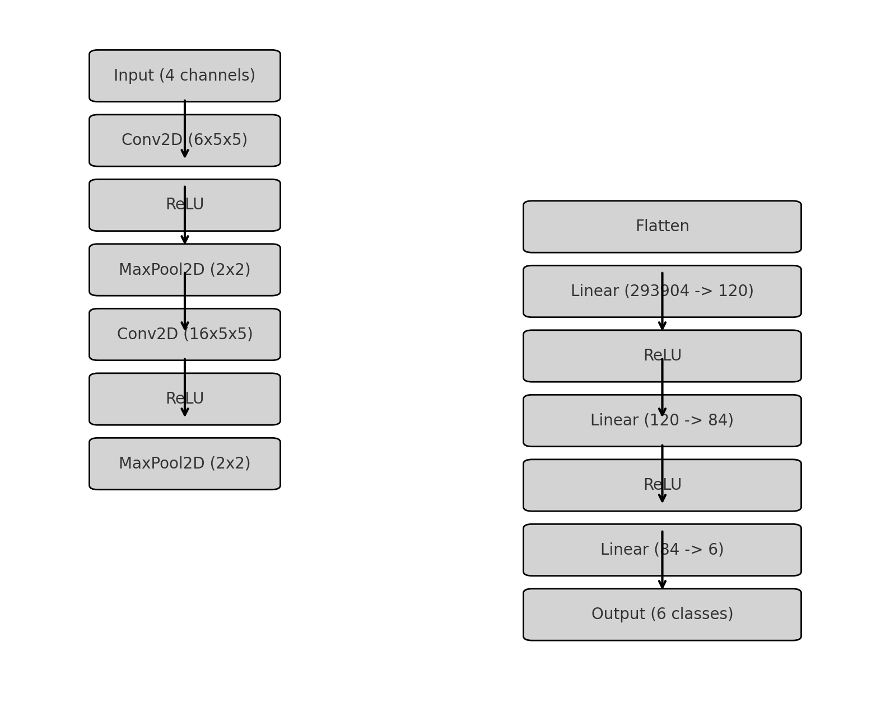
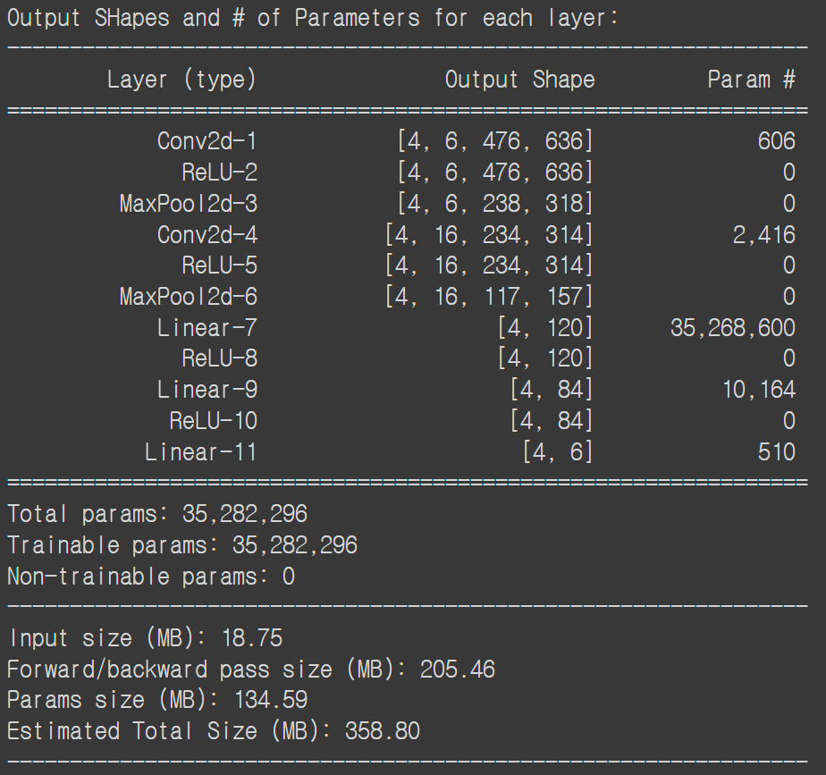
Modeling-specific structure
CNN Model

Slide 25
Modeling-specific structure
Feature extraction
Convolution 1
Max-Pool 1
Convolution 2
Max-Pool 2
4*480*640
6*476*636
6*238*318
16*238*318

Slide 26
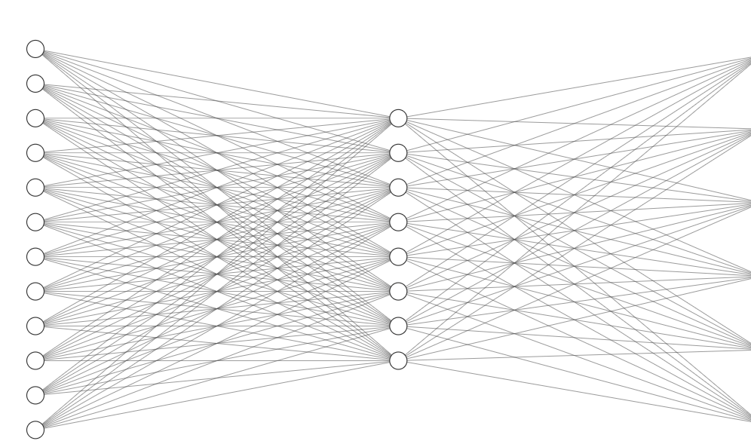
Modeling-specific structure
Classification
Distribution
Flatten
Fully Connected
Output
1x120
Seizure
1x84
LPD
GPD
.
.
.
LRDA
GRDA
Others

Slide 27
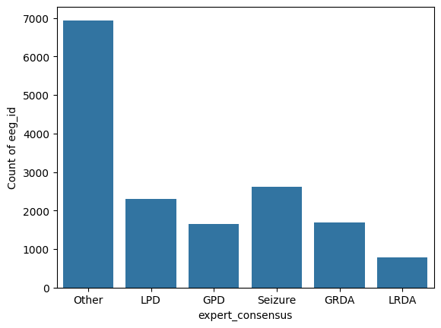
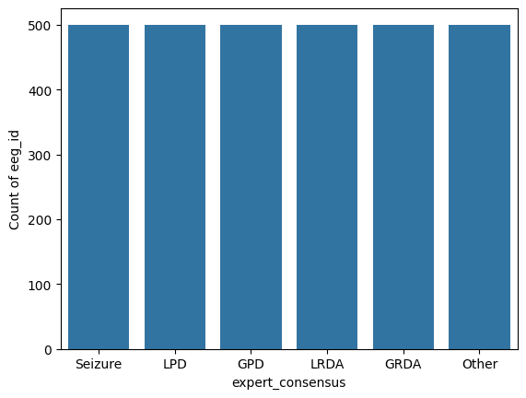
Training

Slide 28
Training
Label: 014523112351251025310……
Accuracy: 19.00%
Label: 0000000001111111111111122222222222222233333333333……
Accuracy: 16.67%

Slide 29
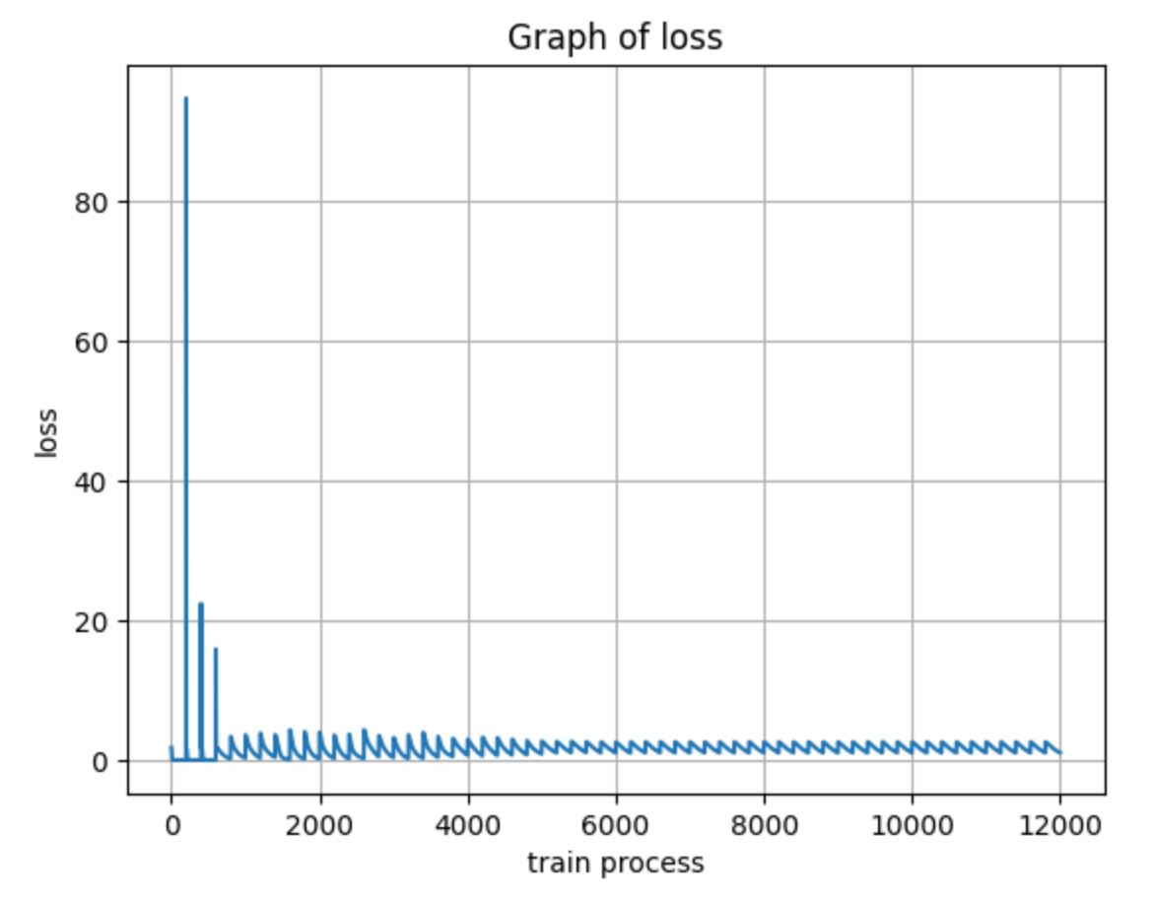
Training
Not shuffled
200 per pattern
Small dataset
Large epoch
10 epoch

Slide 30
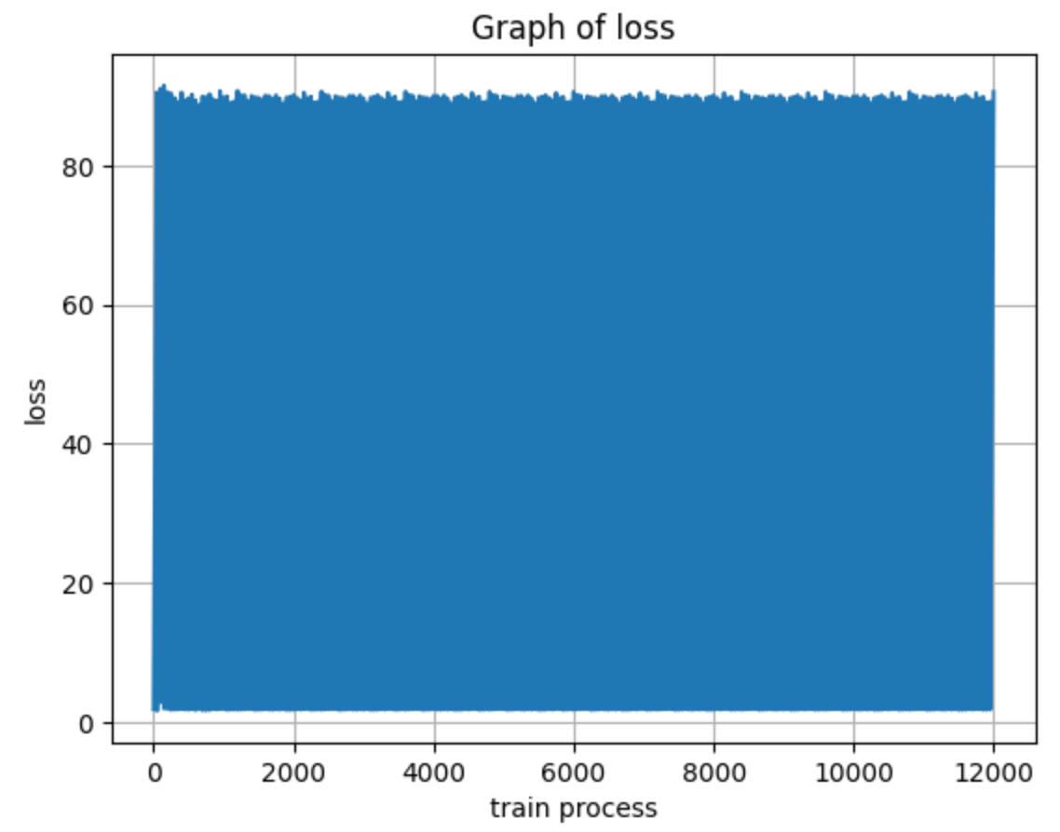
Training
Shuffled
200 per pattern
10 epoch

Slide 31
Result
Model accuracy and evaluation,
Competition score

Slide 32
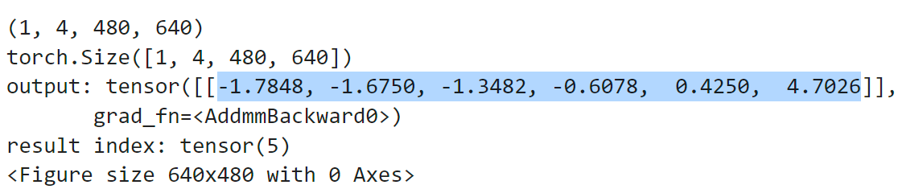
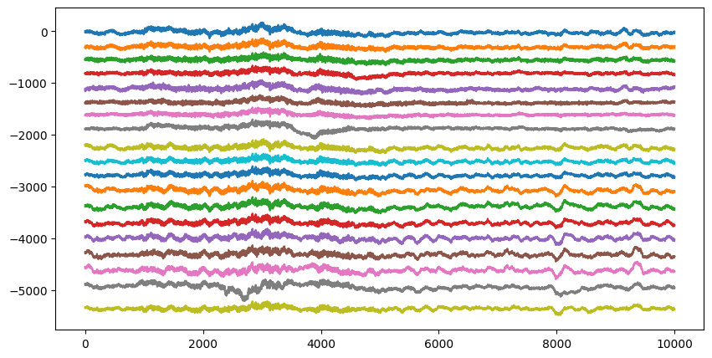
Test data-non shuffled model

Slide 33
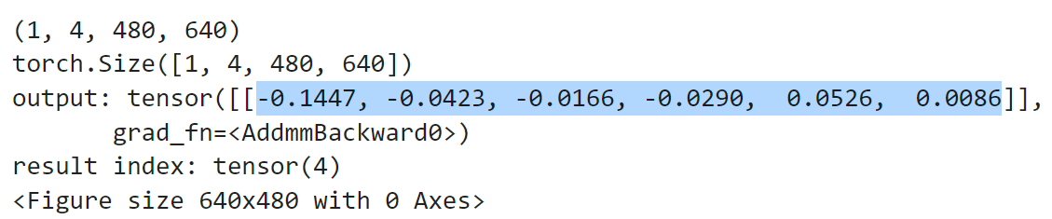
Test data-shuffled model

Slide 34
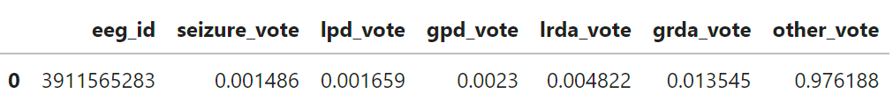
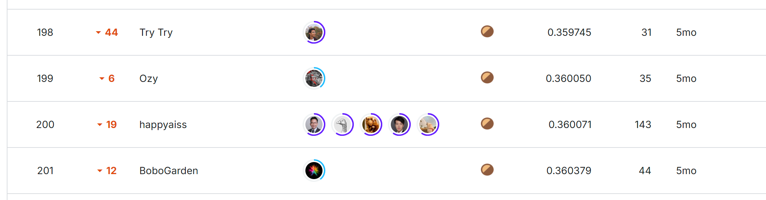

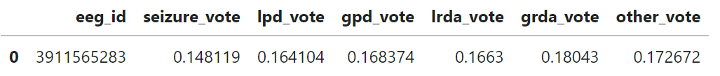
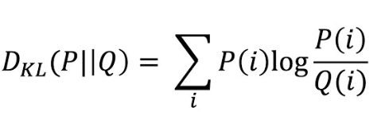
Evaluation
submission.csv from non shuffled model
1.615613 > 1 (out of the leaderboard)
submission.csv from shuffled model
0.360038 (199/2767)
Final score (Kullback Liebler divergence):

Slide 35
Discussion
Future studies and
additional related works

Slide 36
What did I learn
Graph plotting in python using seaborn and matplotlib
.parquet file type to plot image
Using pandas, numpy modules
Dataset handling, datapoint checking
(info, describe, head…etc.)
How to group(chain) EEG cells(signals)
Spectrogram formation
Diagnosis of Seizure and other neural diseases
Various types of brain voltage frequency and their classification
Harmful brain activity classification
Statistical methods to balance data
Preprocessing dataset
Training and testing(evaluation) CNN model
Validation of CNN (Cross Validation)
Modeling,
RAM usage
Training
-> data balancing
Neuroscience
Graph plotting
in python
CNN model producing with python (pytorch)
Processing with efficient RAM usage

Slide 37
Further studies and technology
Mobile personal diagnosis device (application in smartphone)
Partial signal detection (e.g. using only Fp1 and EKG data)
Specified feature extraction and explanation of the disease detection, classification
Wavenet (Wavelet + CNN) -> 8th place solution!
GNN (Graph neural network) -> another way to preprocess raw data

Slide 38

Do you have Any Questions/Feedback?

